Slide 1
Time-Lapse Based Weather Classification
Roman Kolacz

Slide 2
Time-Lapse Based Weather Classification
Using time-lapse footage to infer weather and weather patterns in an area
Day/night
Cloud cover
Weather “icon” (sun, snow, rain, cloudy, etc.)
Precipitation
Temperature
Taking pictures and gathering weather data using a Raspberry Pi and Forecast.io
Using a machine learning library to train a classifier

Slide 3
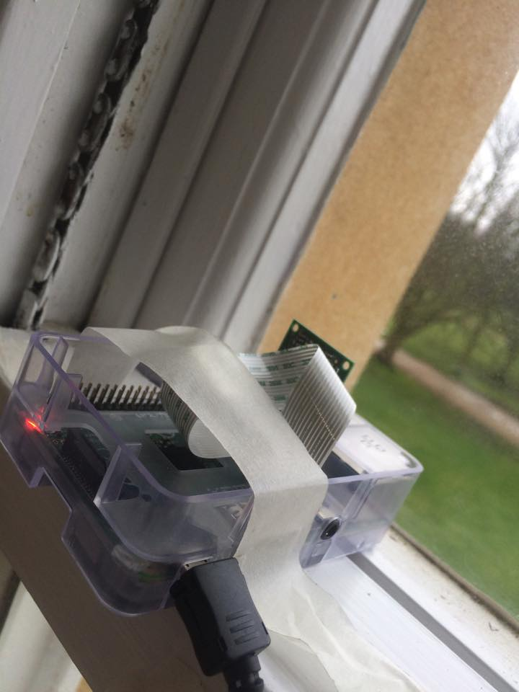

Slide 4
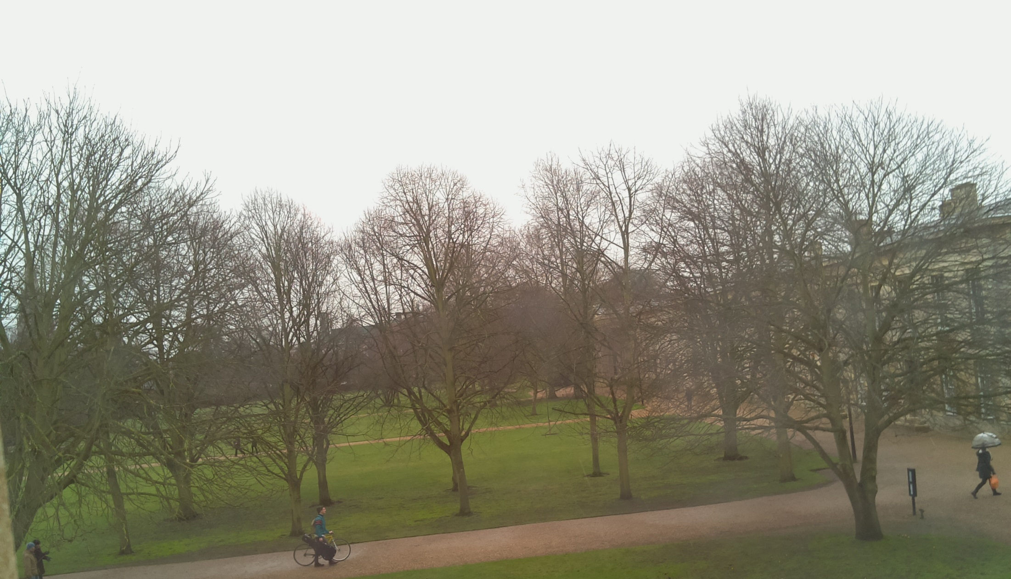

Slide 5
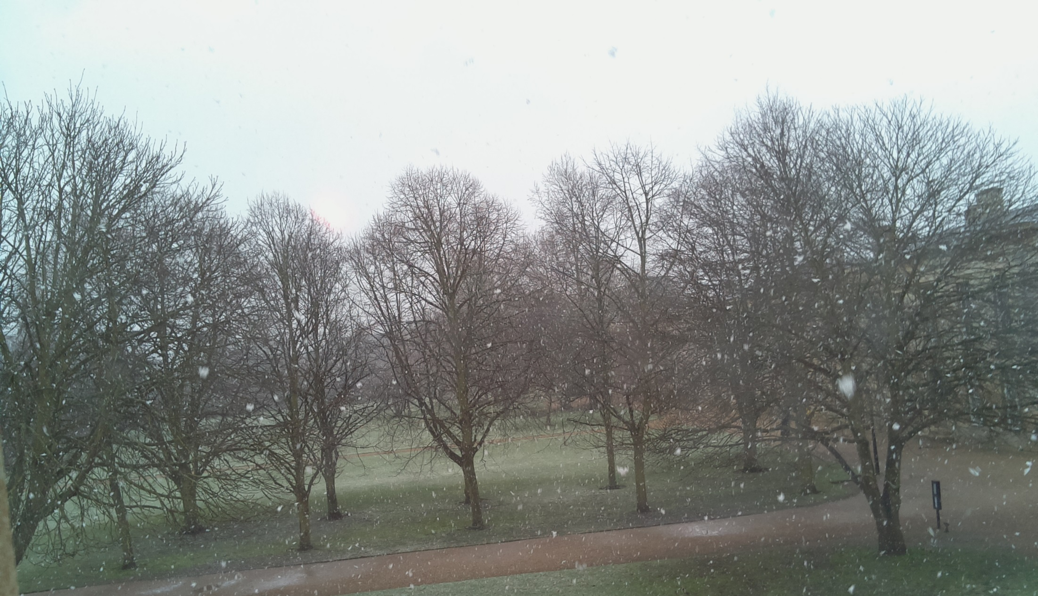

Slide 6
Data Gathering
Taking pictures every 5 minutes
Currently at about 7000 data points
Over three weeks of continuous footage
Concerns about data- specifically with how varied the weather was

Slide 7
Percentage

Slide 8
σ = 0.237
Percentage
Cloud Cover

Slide 9
Classifying
Using image metrics to train a classifier
Initially used a Random Forest with 10 trees
Icon Prediction Accuracy
48.52%
Cloud Cover Root-Mean-Square Error
20.7%

Slide 10
Accuracy
Trees

Slide 11
RMSE
Trees

Slide 12
What Next
Testing different types of classifiers with different parameters
J48 had a 30% accuracy for icon but a 0.135 standard deviation for cloud cover
Potentially:
Trying different image properties
Predicting the weather in the future based on past trends
Write the dissertation

